Slide 1

Analysis of the Opioid Crisis at The County Level
What factors make a county more likely to experience an opioid crisis?
Vid Chan, Doug Neumann, Nicole Yoder
Analytics 501
11/25/2019

Slide 2

Issue
Opioid crisis in the United States.
Goal:
Identify predictive factors for use by policy makers.
Utilize those factors to determine expected opioid density.
Notes:
DOUG

Slide 3

Related Studies
Ghertner and Groves (2018) - Opioid prescription rate compared to poverty and unemployment data.
Haffajee, Bohnert, and Goldstick (2019) - County data and overdose rates.
Che, Sauver, Liu, and Liu (2018) – using machine learning methods developed a predictive model
Notes:
NICOLE
Ghertner and Groves -- found high correlation between poverty/unemployment rates and opioid prescriptions and hospitalizations
Haffajee, Bohnert, and Goldstick -- investigated the characteristics of counties that had high opioid-overdose mortality rates but low availability of treatment. They found that overdose risk was lower in counties that had younger populations and higher densities of primary care clinicians.
Che, Sauver, Liu, and Liu -- used deep and recurrent neural network models on a dataset of opioid users and identified features that predicted long-term use and/or dependency. Some of those were opioid prescriptions, other substance-use disorders, and anxiety disorders.

Slide 4
Data Sources
Drug Data - Washington Post
Arrest rates - FBI
Obesity - CDC
Weather - NOAA’s National Center for Environmental Information
Population, Sex, Age, Education, Race, Poverty, Unemployment, Median Income – Census data
Politics – MIT Election Data and Science Lab
Notes:
DOUG

Slide 5
Data Cleaning & Issues
All data was cleaned and wrangled in Python
Merging data – FIPs
County identification vs City Identification
Some cities in Virginia are considered counties
Alaska strange geographical factors
Missing values (weather unused)
Notes:
NICOLE
-WaPo data was over 70 GB, since it had many columns detailing each prescription, which we took out for our analysis
-WaPo did not have FIPs codes, so we merged based on county names to another dataset that did, then used FIPs for all the rest. Had to manually change some of the county misspellings to match.
- Virginia separates some cities from the surrounding counties (e.g. Alexandria, Fairfax, Falls Church)
-Alaska has census areas and boroughs, but the political data had different districts (counties for all other states)
-Most of our datasets did not have issues with missing values, but weather had so many (over half) that we decided to not to use it
-A couple other datasets did not have the exact years (2006-2012), for instance politics was based on presidential elections since they had county-level data and other elections were district-level. So we used the 2004, 2008, and 2012 elections and used the average rate of change between 04-08 to fill in 05-07 and similarly for 08-12

Slide 6
Exploratory Analysis
Tableau Visualizations
Clustering Visualizations
Notes:
VID

Slide 7
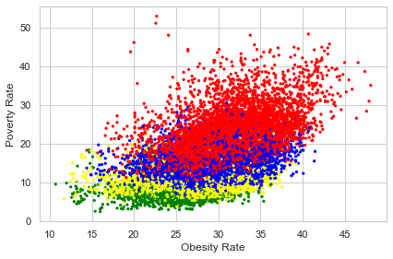
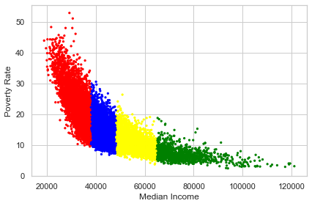
Clustering
Model 1
Silhouette Coefficient: .54
Notes:
VID

Slide 8
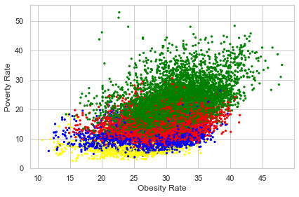
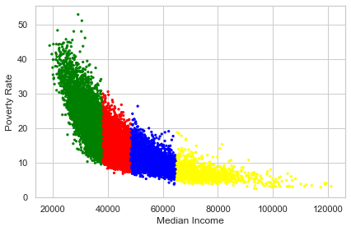
Clustering
Model 2
Silhouette Coefficient: .54
Notes:
VID

Slide 9
Predictive Modeling
Decision Tree
Regression
Notes:
NICOLE

Slide 10
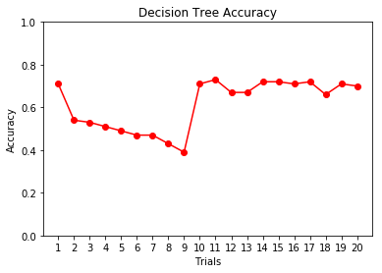
Predictive Model:
Decision Tree
Notes:
NICOLE
-started out trying one or two features at a time
-found that education was working very well (trial 10)
-added one feature at a time, took it back out if it didn’t improve the accuracy
-trial 11 was the best

Slide 11
Best Predictive Factors (Decision Tree)
Education (Less than a High School Diploma, Only High School Diploma,
Some College or Associate's Degree, Has a Bachelor's Degree or Higher)
White Population Percent
73% accuracy predicting the testing set (80/20)
Additional factors that kept accuracy between 70% - 72%:
Politics (percent Democrat/Republican in Presidential elections)
Crime Rate
Notes:
NICOLE

Slide 12
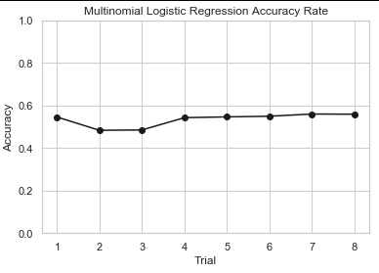
Predictive Model:
Regression
Notes:
VID

Slide 13
Best Predictive Factors (Regression Model)
Education (Only High School or Less)
Female Percent
White Percent
Unemployment Rate
Crime Rate
Republican Percent
Obesity Rate
Poverty Rate
Notes:
VID

Slide 14
User Application
With the research we’ve done, a user could predict drug density. Using our decision tree to predict, the user can be 73% confident in the result.
A state administrator has a set of statistics for four different counties and would like to predict the drug density to help them decide where to optimally allocate resources.
County 1
Poorly Educated, Small Percent White
County 2
Poorly Educated, Large Percent White
County 3
Well Educated , Small Percent White
County 4
Well Educated, Large Percent White
County 5
Charleston Data (2012)
Notes:
DOUG

Slide 15
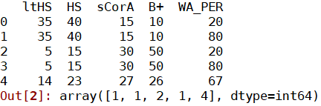
User Application
County Predictions:
County 1: Density Bin 1
County 2: Density Bin 1
County 3: Density Bin 2
County 4: Density Bin 1
County 5: Density Bin 4 (Correctly Predicted Charleston’s 2012 Bin)
Note: Bin 1 has the lowest density, while Bin 4 has the highest density.
Notes:
DOUG

Slide 16
Conclusion
In 2019 the State of South Carolina issued a report detailing:
12 pieces of new legislation signed into law
Over 20 recommendations for further actions.
Notes:
DOUG
ADD UPDATES ON THE FEDERAL LEVEL

Slide 17
Future Work
Temporal Analysis
Different machine learning techniques such as neural network, SVM, etc.
Instead of county-level study, we can look at state-level analysis.
Further analysis of how adjacent counties impact each other.
Additional data points such as number of primary care physicians per county/state.
Notes:
VID

Slide 18
Questions?
Notes:
VID

Slide 19
References
Ghertner, R., & Groves, L. (2018). The Opioid Crisis and Economic Opportunity: Geographic and Economic Trends. Washington, D.C.: ASPE. https://aspe.hhs.gov/system/files/pdf/259261/ASPEEconomicOpportunityOpioidCrisis.pdf
Haffajee, R. L., Lin, L. A., Bohnert, A. S., & Goldstick, J. E. (2019). Characteristics of US Counties With High Opioid Overdose Mortality and Low Capacity to Deliver Medications for Opioid Use Disorder. JAMA Network Open.
Che, Z., St. Sauver, J., Liu, H., & Liu, Y. (2018). Deep Learning Solutions for Classifying Patients on Opioid Use. Deep Learning Solutions for Classifying Patients on Opioid Use. Retrieved from https://www.ncbi.nlm.nih.gov/pmc/articles/PMC5977635/

